Slide 1
Your Next Steps for
transfer
ADMISSIONS

Slide 2
GovState Quick Facts
- Founded in 1969
- 4,427 Students Enrolled
- 12:1 Student-Faculty Ratio
- 49,000 alumni
- 42.6% of Undergraduates are First Generation College Students
- 24 countries represented in our student body

Slide 3
Find the right program for YOU!
College of Arts and Sciences
16 programs, 23 minors
College of Education and Human Development
3 programs, 3 minors
College of Business
5 programs, 8 minors
College of Health and Human Services
7 programs, 2 minors

Slide 4
WHY should you submit your application?
Complete the application online at apply.govst.edu/apply
Submitting the application is FREE
It is not binding; if you which to choose another school, you can.
You can receive a decision sooner than later

Slide 5
How to submit official documents
Reach out to your previous/current institution and order an OFFICIAL transcript to be sent electronically to apotranscripts@govst.edu
We require ALL official transcripts from all previously attended institution

Slide 6
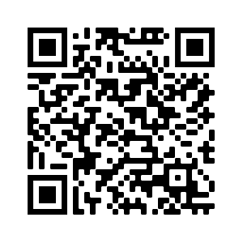
Jaguar Transfer Credit Evaluator
What is it?
The Jaguar Transfer Credit Evaluator is a tool to help transfer students see how their previous college coursework and exams contribute to their degree at GSU! The process is quick, easy, and even provides next steps for transferring.
How do I use it?
Create a profile, select your major, enter in your previous institution and see how the credits transfer to GovState.

Slide 7
Scholarships
GovState Scholarship homepage: www.govst.edu/Scholarships/
Scholarship Universe: www.govst.scholarshipuniverse.com/public
With Scholarship Universe, Students will be able to:
Answer questions and match to scholarship opportunities they are eligible for
The more you answer, the more scholarships you match to
Easily apply online to multiple scholarship opportunities through a personalized portal
See scholarship metrics to determine their chances and effort required to apply
Be alerted whenever they are matched to new scholarship opportunities
GovState and external scholarships
All vetted = no questioning if the scholarship is legit

Slide 8
AIM HIGH – Transfer Students
Guaranteed Transfer Scholarships for up to $5000 per year
No application necessary!
Must have earned an associates degree at a community college or transfer from another 4-year institution.
Renewable for 4 semesters.
Full criteria available online based on your entry term
govst.edu/aimhigh-transfer/

Slide 9
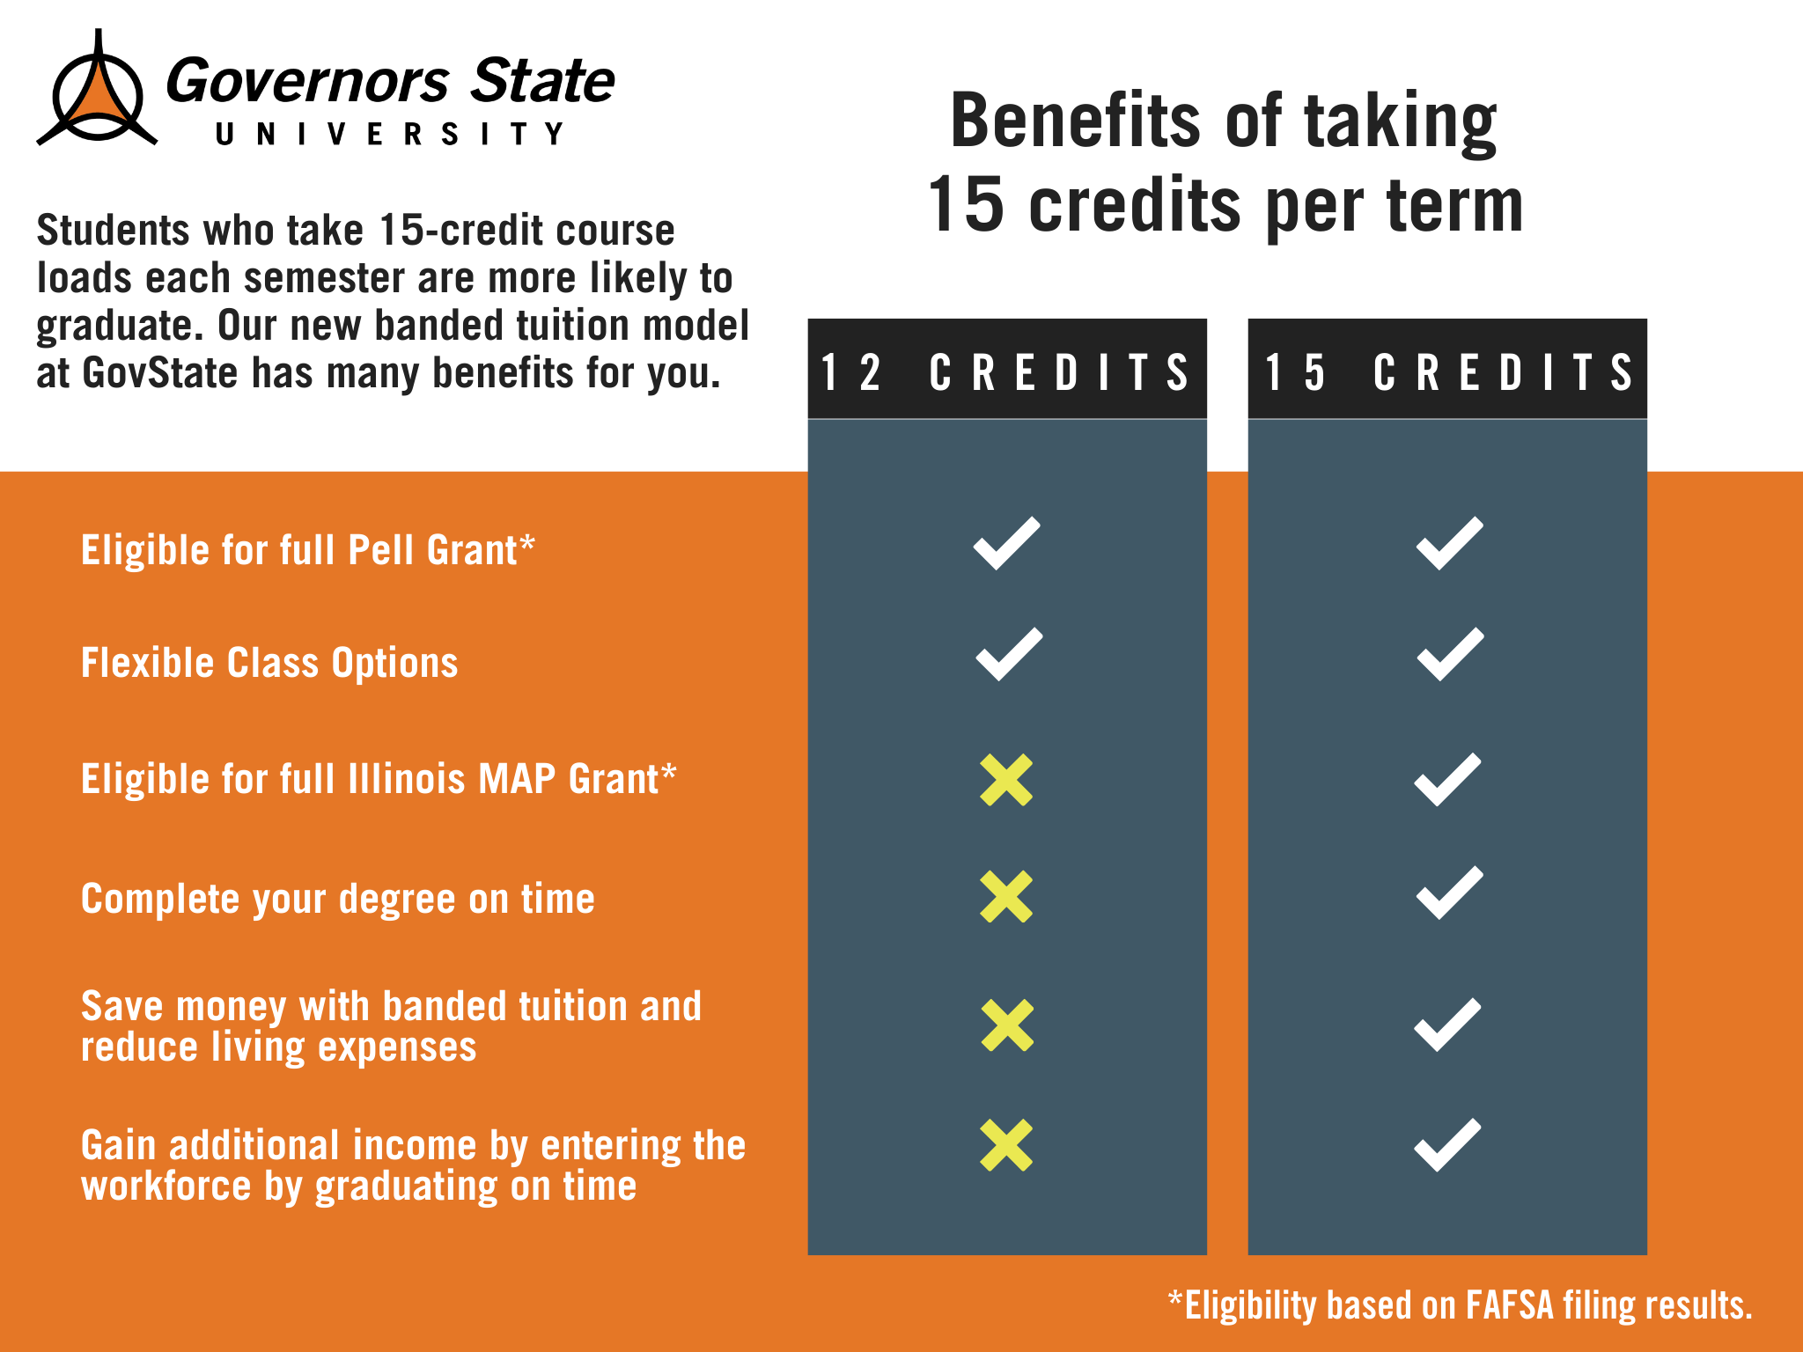
New for 24-25- Banded Tuition
All new students will be charged banded tuition starting in Fall 2024.
Allows students to be charged the same tuition if you are taking 12 credit hours or more!

Slide 10
Living on Campus- Prairie Place
Only available for admitted students
First come first serve basis; spaces are limited and go quickly
$25 application fee
$100 pre-payment fee to reserve your space
We expect to be filled again in the Fall 2024, so it is CRITICAL that if you want to live on-campus you submit a housing application in a timely manner
Check your GovState email for updates.

Slide 11
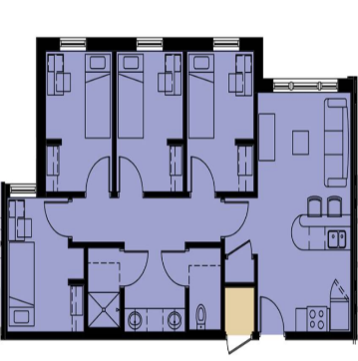
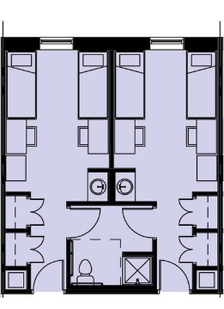
Unit Types in Prairie Place
Semi-Suite – share bedroom; bathroom connected to next room
4 bedroom apartment
(single bedroom)
$10,154/annually
$7,104/annually

Slide 12
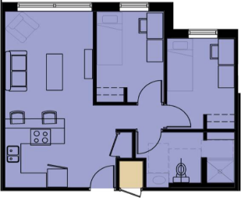
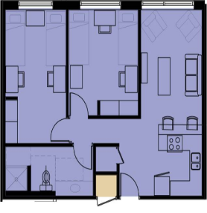
Unit Types in Prairie Place
2 bedroom apartment
(single bedroom) LIMITED availability
2 bedroom apartment – share bedroom with roommate, 4 people in total
$8,360/annually
$12,046/annually

Slide 13
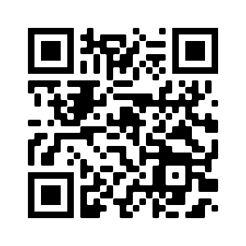
Transfer Thursday
Get on-the-spot admissions decisions.
Visit campus
Get your next steps to enrollment
Visit the FA office
No application fee!
*RN to BSN and Social Work applicants cannot receive an instant decision.

Slide 14
Transfer Admissions Checklist

Slide 15
Transfer Admission Checklist
Submit your application: You can apply online or come in the admissions lobby and we will assist you on the computers.
Submit all required documents: Order official transcripts to be sent to apotranscripts@govst.edu and make sure recommenders complete recommendation form.
Complete the Free Application for Federal Student Aid (FAFSA): at www.FAFSA.gov to qualify for all types of financial aid. Use GovState’s school code—009145—to make sure we receive your financial aid information.
Complete housing application: Once admitted, apply for housing!
Scholarships: Fill out the questionnaire and apply for scholarships through Scholarship Universe.

Slide 16
Ways to Connect to Admissions
Lise’ Schneider:
lschneider@govst.edu
708-534-7059
Craig Berry:
cberry@govst.edu
708-534-4492
Tomice O’Brien
tobrien2@govst.edu
708-235-7170
Bailie Antwiler:
bantwiler@govst.edu
708-235-6841
Direct Link: www.govst.edu/admissions/
Spanish Language Virtual Appointments Available

Slide 17
Questions?

